Slide 1

Discovering the Spatial Extent of Relative Attributes
Fanyi Xiao and Yong Jae Lee

Slide 2

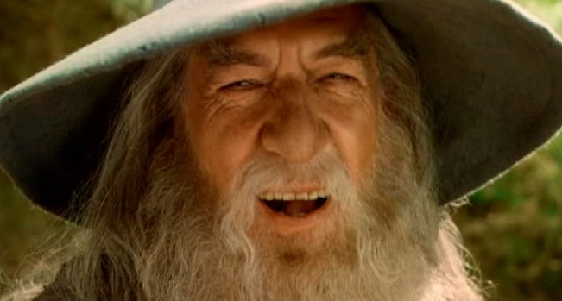
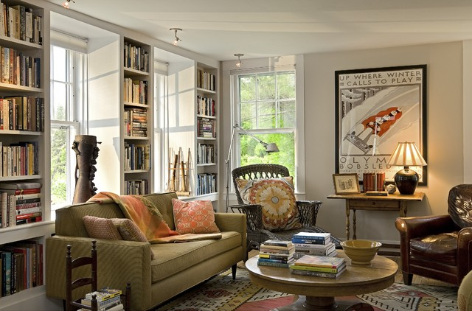
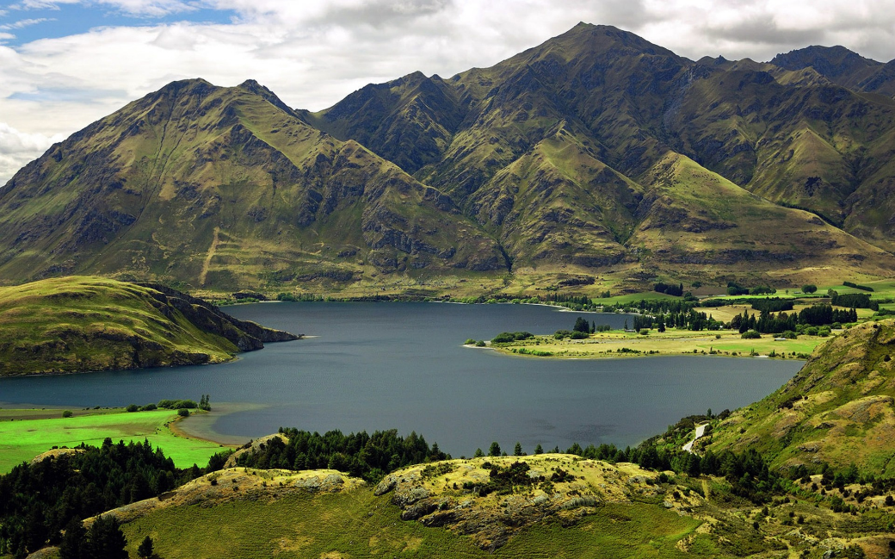
Visual attributes
High heel
Smile
Cozy
Mountainous
[Farhadi et al. 2009, Kumar et al. 2009, Lampert et al. 2009, Berg et al. 2010, Rastegari et al. 2012, …]

Slide 3

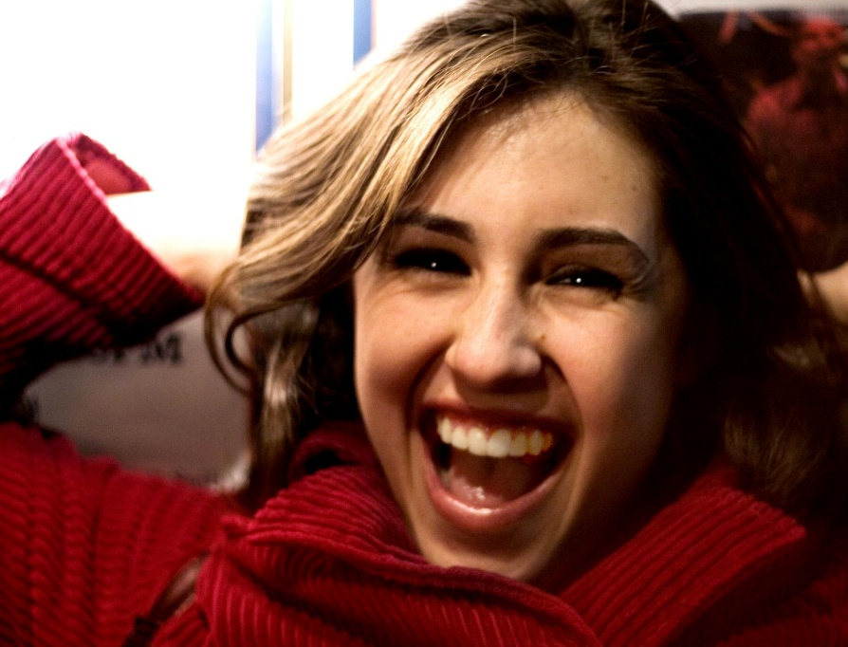
Relative attributes
<
Is she smiling? Hard to say...
Lot easier to say "the right one is more smiling"
[Parikh & Grauman 2011, Shrivastava et al. 2012, Kovashka et al. 2013, Sandeep et al. 2014, …]

Slide 4
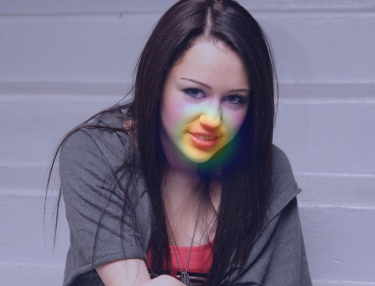
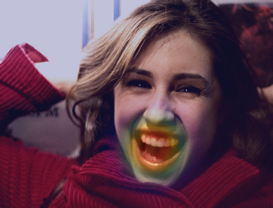
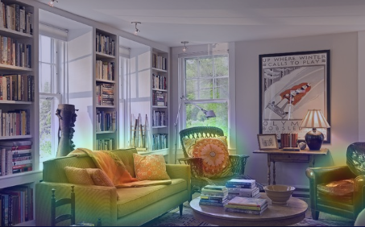

Spatial extent of attributes
Smile
Cozy
Mountainous
Spatial regions that are most relevant to a particular attribute

Slide 5
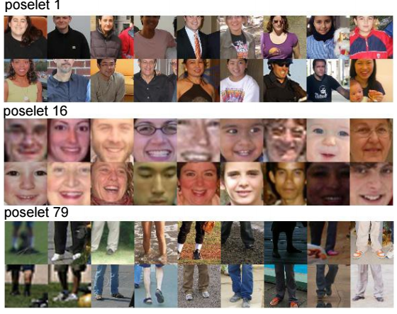
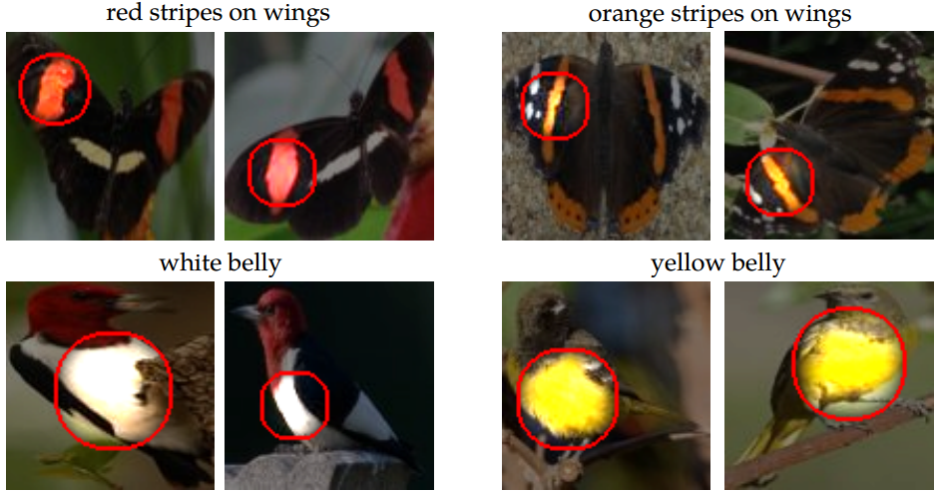
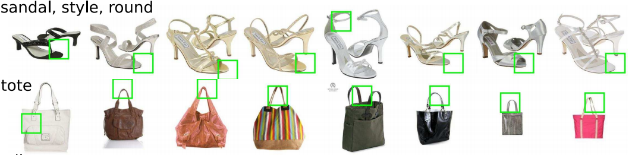
Prior work on localizing attributes
Attribute localization with pre-trained detectors:
[Bourdev et al. 2011, Zhang et al. 2014, Sandeep et al. 2014]
Requires strong human supervision
or binary attribute annotations
Attribute localization with human-in-the-loop: [Duan et al. 2012]
Attribute localization with binary attributes: [Berg et al. 2010, Bourdev et al. 2011, Duan et al. 2012, Zhang et al. 2014]

Slide 6
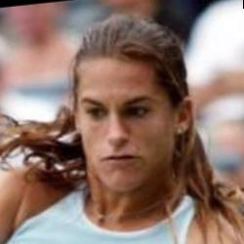

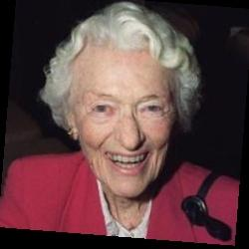
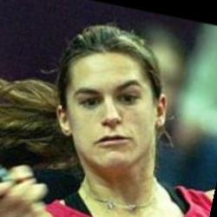


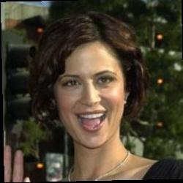





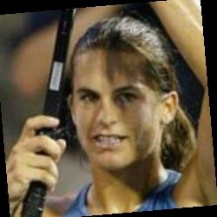



Our goal: weakly-supervised relative attribute localization
Input: training pairs of ordered images + testing images
Attribute: Smile
Testing images
Training pairs

Slide 7
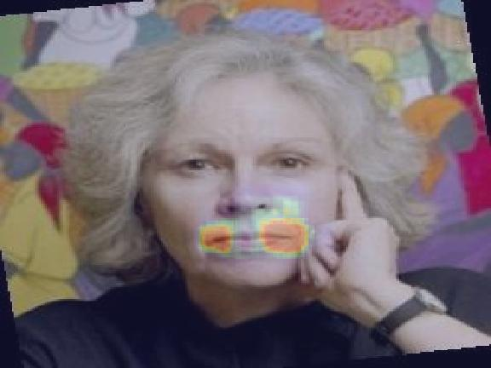
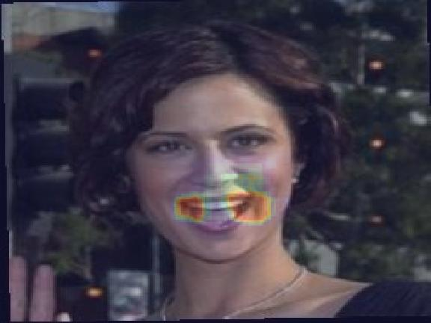
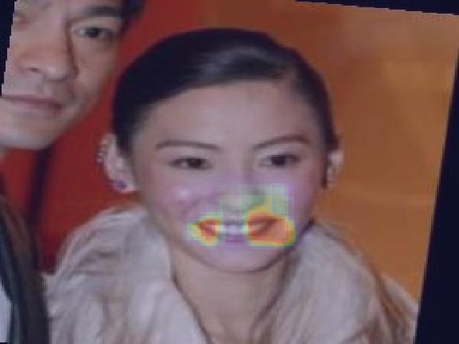
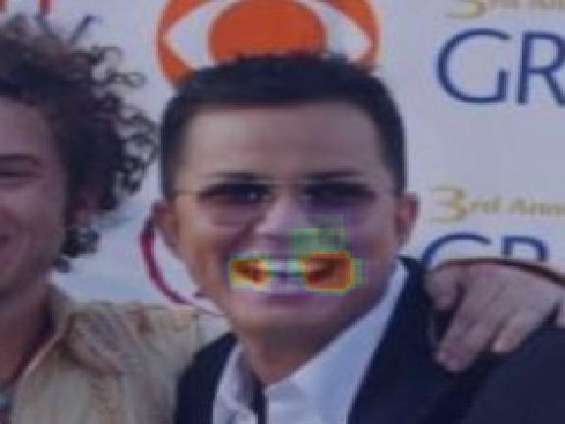
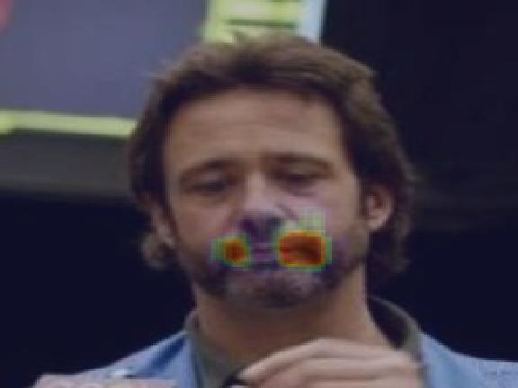
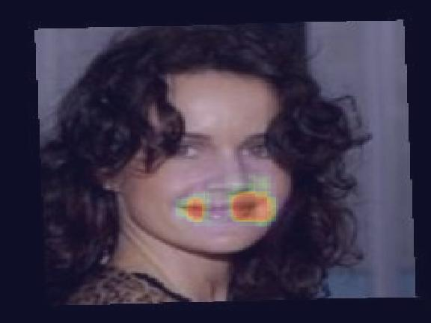
Our goal: weakly-supervised relative attribute localization
Output: (1) discover spatial extent of relative attribute
Attribute: Smile

Slide 8
Our goal: weakly-supervised relative attribute localization
Output: (2) rank images based on attribute strength
Predicted Attribute Strength
Strong
Weak
Attribute: Smile

Slide 9


Localization can be difficult for
relative attributes
Who is "smiling" more?

Slide 10
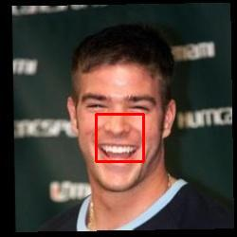
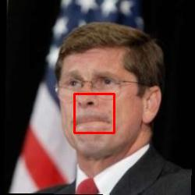
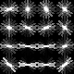
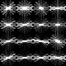
Localization can be difficult for
relative attributes
Who is "smiling" more?
Easily judged by focusing on the "right" region

Slide 11
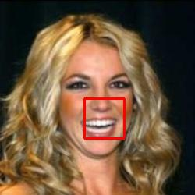
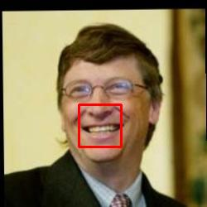
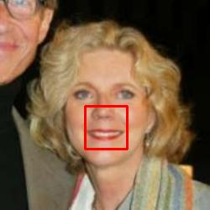
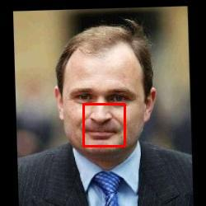
Key idea: discover visual chains
Attribute Strength
Strong
Weak
......

Slide 12

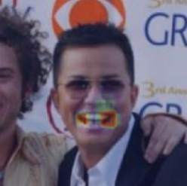


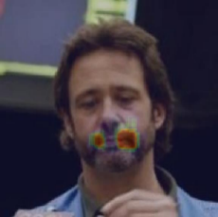
Key idea: discover visual chains

Slide 13
Approach

Slide 14
Initializing chains
Train a ranker with pairs of ordered images and global features [Parikh & Grauman, 2011]
Attribute: Smile

Slide 15
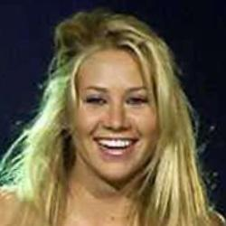





Initializing with local smoothness
Rank and select top ranked images
Predicted Attribute Strength
Strong
Weak
...
...

Slide 16
Initializing with local smoothness
Search for locally similar-looking patches

Slide 17
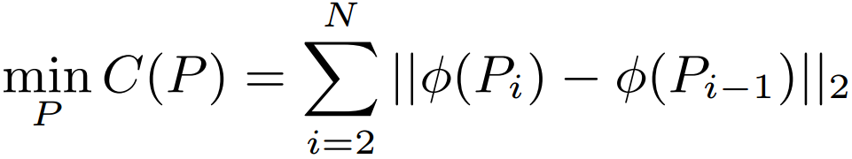
Initializing with local smoothness
Search for locally similar-looking patches
Solve for

Slide 18
Initializing with local smoothness
Search for locally similar-looking patches
Solve with dynamic programming
Solve for

Slide 19
Initializing with local smoothness
Compute multiple initial chains

Slide 20

Iterative growing of visual chains
Train a detector for the chain
Learn detector

Slide 21




Iterative growing of visual chains
Select image subset based on ranking
Predicted Attribute Strength
Strong
Weak

Slide 22
Iterative growing of visual chains
Select image subset based on ranking
Predicted Attribute Strength
Strong
Weak
iter 1

Slide 23
Iterative growing of visual chains
Search for patches
Initial image set

Slide 24
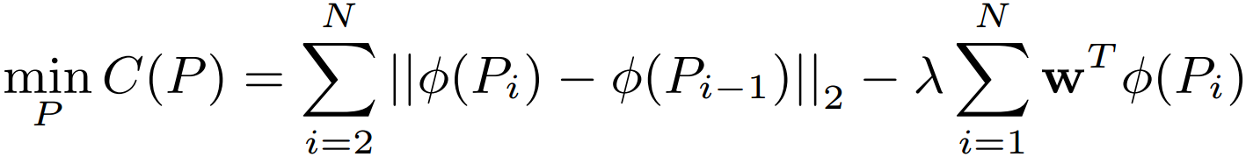
Iterative growing of visual chains
Search for patches
Initial image set
Solve for

Slide 25
Iterative growing of visual chains
Search for patches
Solve with dynamic programming
Solve for

Slide 26
Iterative growing of visual chains
Select image subset based on ranking
Predicted Attribute Strength
Strong
Weak
iter 1

Slide 27
Iterative growing of visual chains
Update the detector
Initial chain
Learn detector

Slide 28
Iterative growing of visual chains
Select image subset based on ranking
Predicted Attribute Strength
Strong
Weak
iter 1
iter 2
iter 3

Slide 29












Creating a chain ensemble

Slide 30













Creating a chain ensemble
Train SVM ranker with discovered patches
Validation set
Attribute: Smile
Score: 3/4
Apply ranker to validation set

Slide 31

Creating a chain ensemble
Scores
High
Low

Slide 32

Creating a chain ensemble
: Dense SIFT or Pool5 activation of AlexNet
Learn final image-level SVM ranker [Parikh & Grauman 2011]

Slide 33
Results

Slide 34



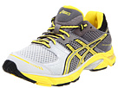
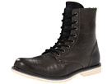
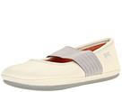

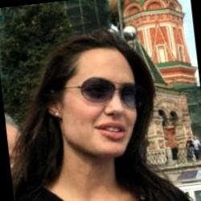

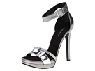
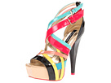
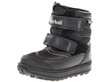


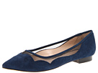
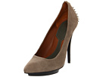
Relative attribute datasets
LFW-10 (2k images)
[Sandeep et al., CVPR 2014]
UTZappos50k (50k images)
[Yu & Grauman, CVPR 2014]
Visible teeth, Eyes open, Dark hair, Smile, Good looking...
Pointy, Open, Sporty, Comfort

Slide 35

Spatial extent of attributes
Attribute: Smile
Fire detectors from top-ranked visual chains

Slide 36
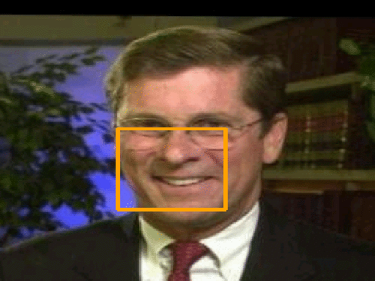
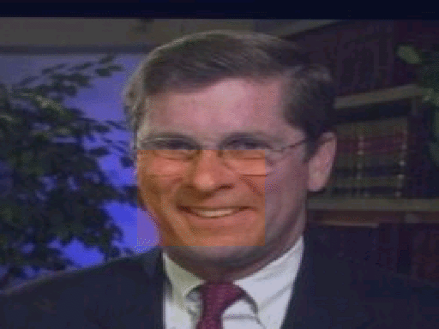
Spatial extent of attributes
Attribute: Smile
Fire detectors from top-ranked visual chains

Slide 37
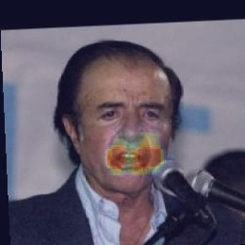
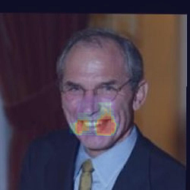
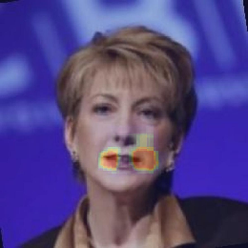
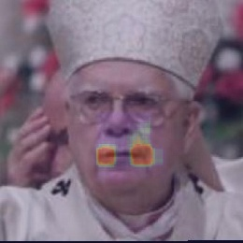
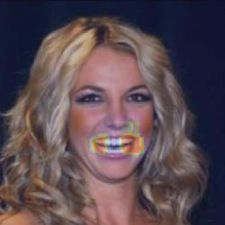










Spatial extent of attributes
Predicted Attribute Strength
Strong
Weak
Ours
[Parikh & Grauman 2011]

Slide 38
































Spatial extent of attributes (LFW10)
Predicted Attribute Strength
Strong
Weak
Smile
Visible
teeth
Bald
head
Dark
hair

Slide 39
































Spatial extent of attributes (LFW10)
Predicted Attribute Strength
Strong
Weak
Visible
forehead
Eyes
open
Good
looking
Young

Slide 40
































Spatial extent of attributes (UTZAP50K)
Predicted Attribute Strength
Strong
Weak
Open
Comfort
Pointy
Sporty

Slide 41








Relative attribute ranking
Test set
Attribute: Smile
Apply ranker to test set

Slide 42

Relative attribute ranking
Mean attribute ranking accuracy (%) on LFW-10

Slide 43

Relative attribute ranking
Mean attribute ranking accuracy (%) on UTZAP50K

Slide 44
Relative attribute ranking
Train on UTZAP50K → Test on Shoes-with-Attributes

Slide 45











Application: attribute editor
Predicted attribute strength
strong
weak
Attribute: Pointy

Slide 46







Application: attribute editor
Predicted attribute strength
strong
weak
Attribute: Pointy
Attribute: Comfort

Slide 47
Conclusion
Discover attribute’s spatial extent with weak supervision
Key idea: Construct visual chains to cover attribute spectrum
Better models relative attributes than baselines that use global appearance features or stronger supervision
We will share our source code on the project page
Thank you!

